Slide 1
Sentiment Analysis FYP
Ciaran mcgarry Student ID: 14321016
Supervisor: Prof. Khurshid Ahmad

Slide 2
What is Sentiment Analysis?
Sentiment Analysis is “a process of determining whether a piece of information is positive, negative, or neutral” (Mira Dholariya, Dr.Amit Ganatra, Prof. Dhaval Bhoi, 2017) .
To put it more technically, Sentiment Analysis employs AI-based text analysis to extract attitudes and emotions from a piece of text.
Sentiment Analysis has applications in any domain in which decision-making is influenced by the perception of others e.g. politics, stock prices, entertainment.
Notes:
Sentiment Analysis is also termed opinion mining, mood extraction and emotion analysis

Slide 3
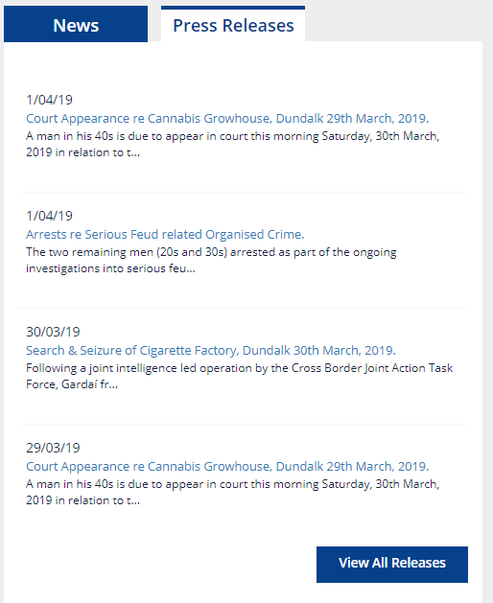
What is the problem?
The performance of the Garda is inherently tied to public opinion. As a branch of the Irish Government they are funded by taxpayer money, meaning the well-running of the service is in the public interest.
As a result, the managing of public opinion is also in the Guards’ interest. To achieve this, the Gardaí send out regular press releases which control the supply of information to the media.
But how to tell if these press releases are having the desired effect? This problem of tracking sentiment will be the focus of this project.

Slide 4
Why did I select this project?
It seemed an ideal intersection of my interests in language, media, maths, and computing.
Following some casual reading of Sentiment Analysis on Wikipedia, I read my friend’s Final Year Project titled ‘An Analysis of Sentiment Shifting Words at a Sentence Level Granularity’ (Dave Woods, 2016) to get a sense of what a project in this field might entail.
Background reading of previous research in the field such as “Techniques and applications for sentiment analysis” (Ronan Feldman, 2003), “A Survey on Sentiment Analysis: Tools and Techniques” (Mira Dholariya, Dr.Amit Ganatra, Prof. Dhaval Bhoi, 2017), and “Sentiment Analysis and Opinion Mining” (Bing Liu, 2012) confirmed the confluence of maths and language in this field.
From my background reading, I was happy that a project in Sentiment Analysis would be of interest to me.
Notes:
Ronan Feldman -- in which Sentiment Analysis is described as 5 separate areas of Document-Level, Sentence-Level, Aspect-Based, and Comparative Sentiment Analysis, as well as Sentiment Lexicon Acquisition
Bing Liu – very large document so selectively read pertinent chapters. Reads as a thorough description to my untrained eyes.

Slide 5
Method of Solution - Overview
In order to address the problem of the Garda effectively tracking public sentiment, this project aims to create a tool to intuitively inform its users of changes in how the police and crime were spoken of in the press.
To achieve this, an initial design of a window split between displaying the number of newspaper articles released in the last hour, and the average positive sentiment value of those articles was decided upon.
To improve user experience, it was decided that the sentiment portion of the window should change colour in accordance with the sentiment (red-green).
Form factor was a major influencer in this design, as screen-space was understood to be a commodity and interrupting the users workflow to change window focus was not desirable.
Notes:
The tracker was designed to sit in the corner of the screen, its colours attracting attention whenever something interesting was happening. The user can then glance at the noArticles to decide significance. A chart screen was added for increased visibility of what was going on behind the scenes.
The user to having to switch back and forth between screen focuses was not desired.

Slide 6

Method of Solution 1: Acquire Data
Newspaper articles relating to the Garda were acquired via Lexis-Nexus, having searched for the terms ‘Garda’ and ‘Crime’ in Irish newspaper articles.
Next the data was separated by hour and processed using Rocksteady, a sentiment analysis tool, using a general dictionary and one of my own making relating words to categories of ‘Crime’ and ‘Garda’.
Entries with a lower than 0 Z-score for relevance were removed as not pertinent.
The resulting data was exported to a CSV file.
Notes:
Dictionary was created using terms found in the Garda website, the Garda hierarchy structure, and a thesaurus

Slide 7


Method of Solution 2: Server
The data was then parsed into JSON using Python and stored locally. Python was selected for the server-side as there are many natural language processing libraries should the project later expand in that direction
Flask, a micro web framework, was used to create a server which would respond to requests for sentiment data with JSON filtered by a passed date and time window tolerance

Slide 8




Method of Solution 3: Client-Side
The front-end was built in Electron which allows web applications to run as though they are desktop applications. It also allows control over multiple windows and their behaviour.
JQuery was used to create GET requests to the server and update HTML elements as necessary.
Bootstrap was used for frontend design.
An chart window was created using Chart.js.
Code was written in HTML, CSS, and Javascript languages.

Slide 9
Summary of Solution Algorithm
Having already acquired data from LexisNexis and processed with Garda_Crime_Dictionary and Rocksteady:
Client sends GET request to server (repeats on given time interval).
Server receives GET request from client with date and time-tolerance data.
Server filters JSON according to date and time and returns sentiment values.
Client receives values and stores them along with the previous 12hrs worth for Chart Window to read, then updates HTML elements accordingly.
If at any point the info button is clicked, a second window appears displaying a chart with various togglable lines for the previous 12hrs of data.

Slide 10
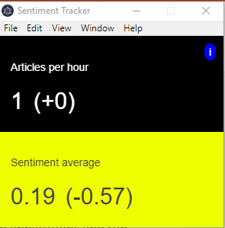
The Results
This displayed sentiment tracker shows the number of articles published in the last hour, the average positive sentiment Z-score of those articles, and their respective change from previous values.
The lower half of the screen updates its colour dynamically according to the current sentiment value. The simplicity of this design means the impact of the tool on screen space is reduced.
An info button on the top right of the screen opens a second chart window on being clicked.

Slide 11
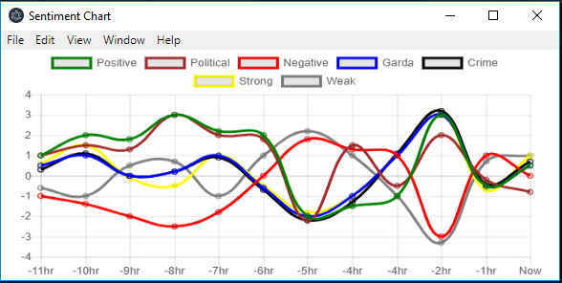
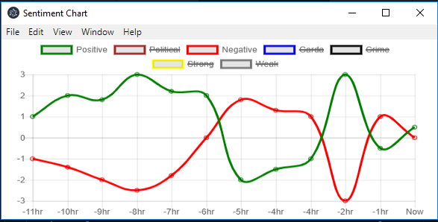
The Results
Chart displays various data values collected over the last 12hrs.
Lines on the chart can be toggled visible/invisible by clicking on their related colour in the legend.
Hovering over a line gives the x, y values and label.
Chart adjusts in scale automatically depending on lines shown.
Chart is the ‘child’ of home window, and closes when it does.
Advantages to two windows: no need to reorganise screen space following opening and closing of chart window.

Slide 12
What has been learned?
Many areas this project visited were new to me, and so provided a stepped learning curve.
An understanding of the basic concepts and terminology of Sentiment Analysis.
My first introduction to frontend development, and all its libraries and frameworks (sending information between two Electron windows proved a stumbling block).
The confidence that I can create an application from start to finish, both backend and frontend, server and client.
A greater appreciation of the importance of clarity of vision, planning ahead, and both writing and commenting clear code.
Notes:
TFIDF, short for term frequency–inverse document frequency, is a numerical statistic that is intended to reflect how important a word is to a document in a collection or corpus.

Slide 13
What could be improved?
The server was written in Python with a view of possibly using Python’s natural language processing libraries to obtain article headlines and display them along the bottom of the client in a rolling-news style. This proved to be outside the scope of the project but the foundation is there for the future.
As much of my learning was done as I tackled with the problems, some of the ways I structured early parts of the project were problematic as I had misunderstood how they would interact with later parts. This cost time, but did offer learning opportunities.
There is the potential to add various visualisations of data to the chart page.
Automating the data acquisition and processing steps would be an improvement.

Slide 14
Q&A
Thank you very much.

